Slide 1
AI

Slide 2
Artificial Intelligence
8.1.1 Introduction

Slide 3
CPSC 470/570 Artificial Intelligence
Instructor:
Dragomir Radev
dragomir.radev@yale.edu
Class times:
TTh 4-5:15
Davies Auditorium, 15 Prospect
TF
Meiying Qin
ULA
Soumya Kambhampati
Andrew Malta
William Merrill

Slide 4
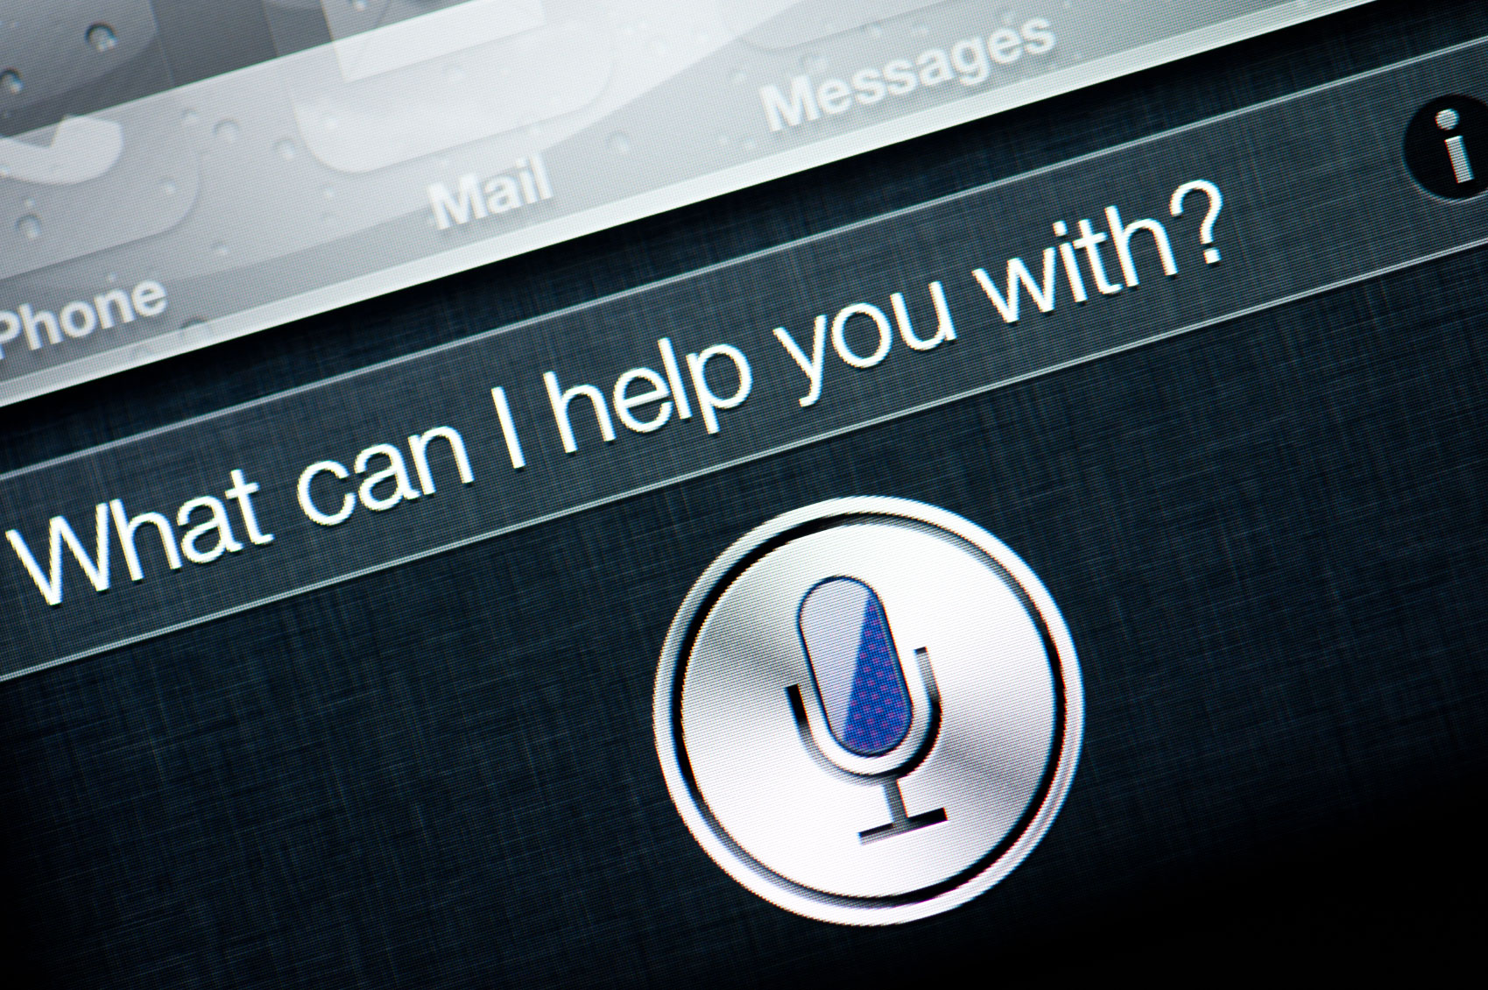
http://electronics.howstuffworks.com/gadgets/high-tech-gadgets/siri.htm

Slide 5
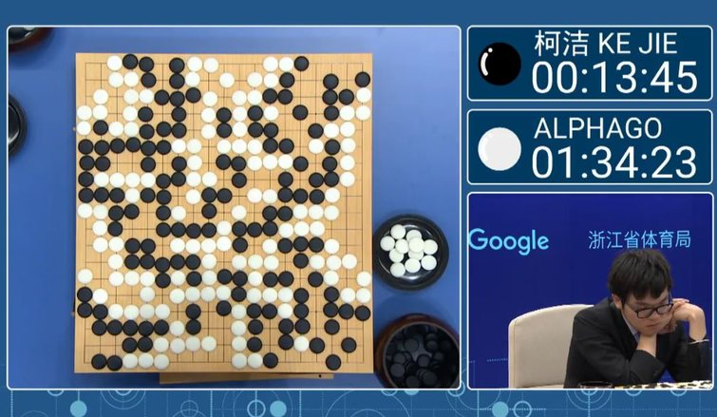
http://www.tomshardware.com/news/alphago-narrow-win-ke-jie,34486.html

Slide 6
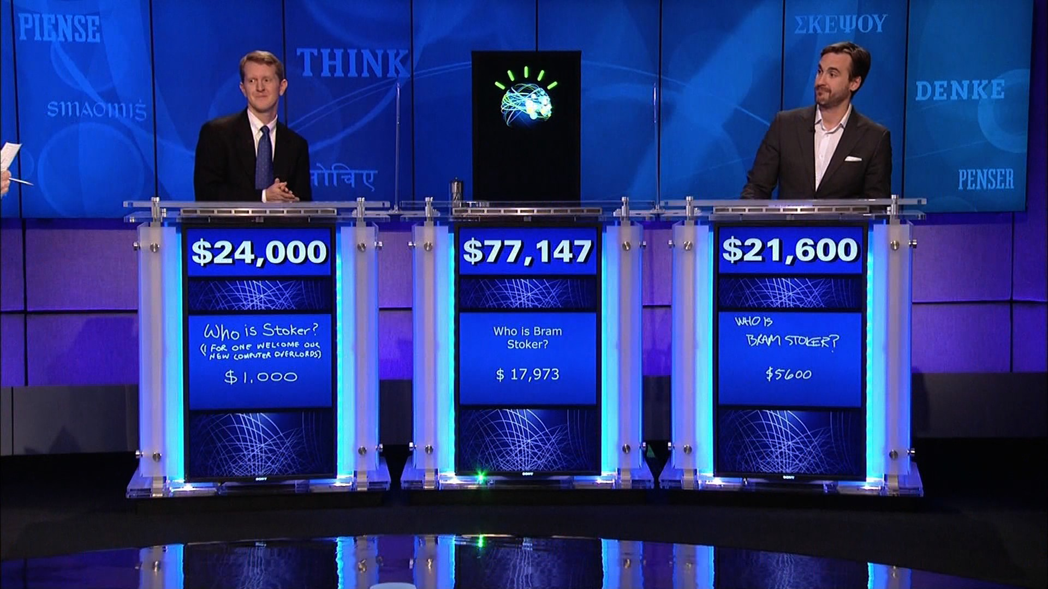
http://www.geekwire.com/2013/ibm-takes-watson-cloud/

Slide 7
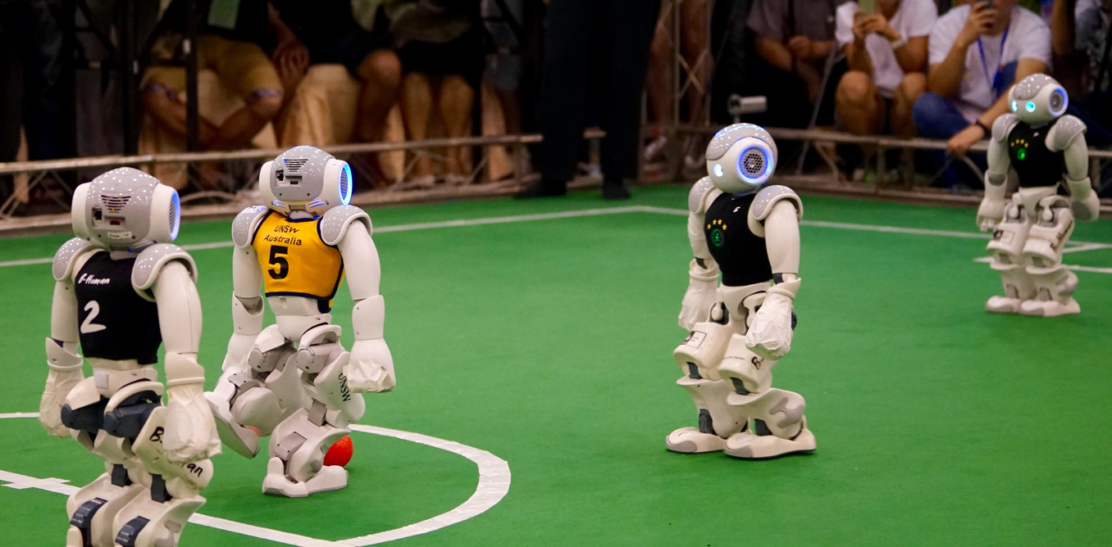
Sean Harris
https://theconversation.com/how-we-won-the-world-robot-soccer-championship-45156

Slide 8
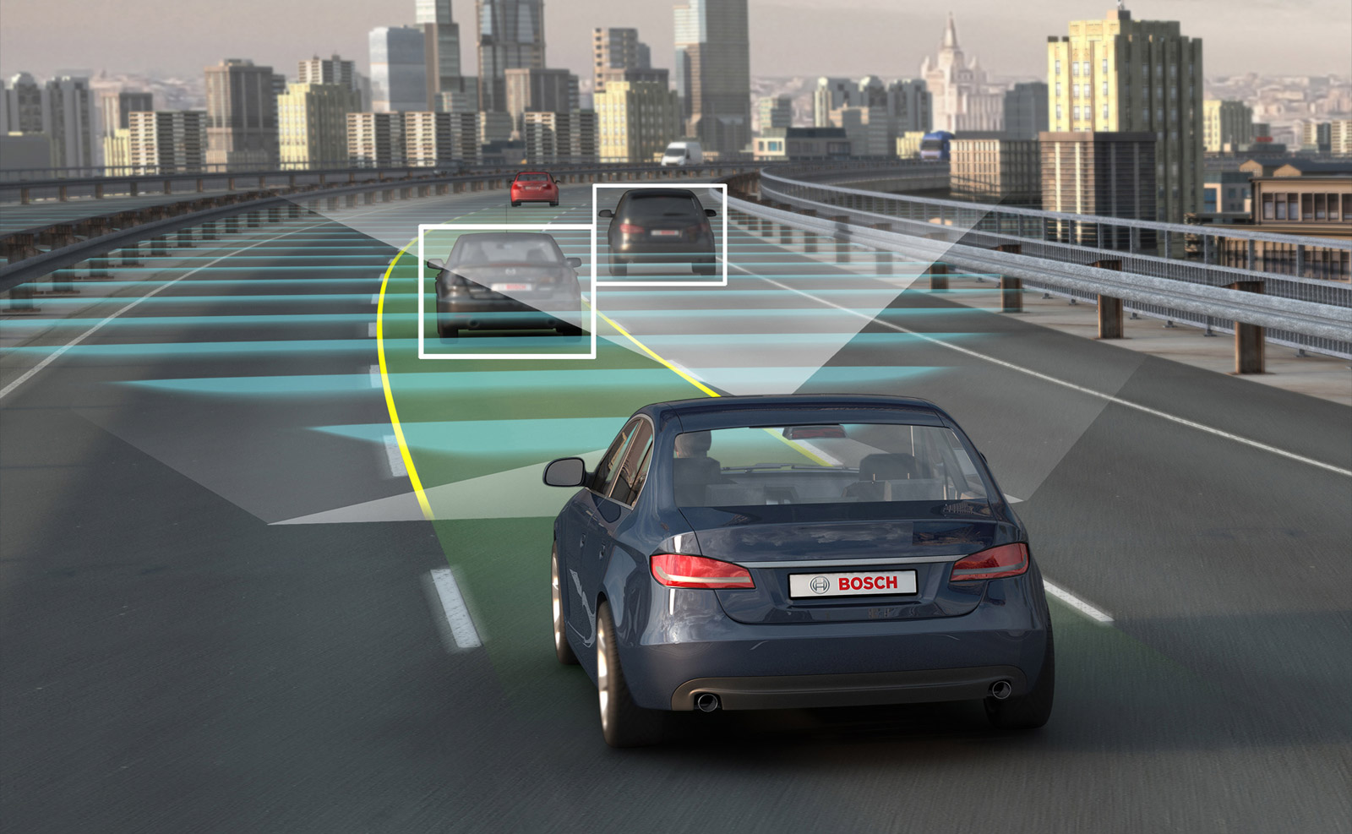
https://infograph.venngage.com/p/97547/autonomous-cars-infographic-group-work

Slide 9
Lecture Outline
Course overview
Logistics
What is AI?
A brief history
The state of the art
Programming languages

Slide 10
Major Goals of the Class
Learn the basic principles and theoretical issues underlying artificial intelligence
Understand why artificial intelligence is difficult
Learn techniques and tools used to build practical, realistic, robust AI systems
Understand the limitations of these techniques and tools
Gain insight into some open research problems in AI
Notes:
MOVE ELSEWHERE?

Slide 11
Practically…
Playing games
Language
Learning
Interacting with the environment

Slide 12
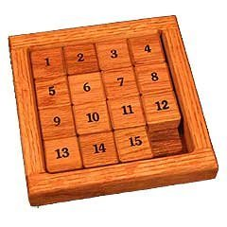
15 Puzzle

Slide 13
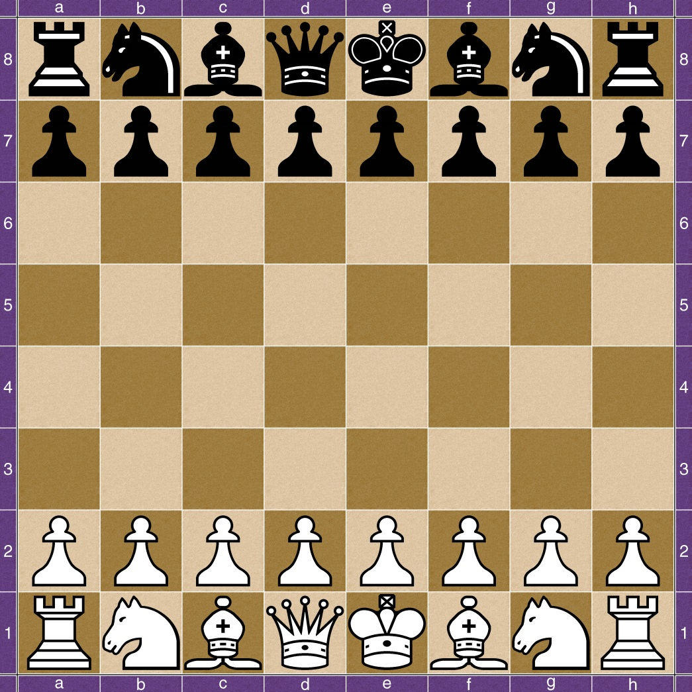
Chess

Slide 14
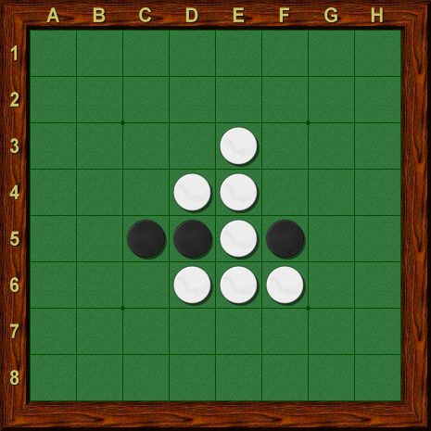
Othello/Reversi

Slide 15
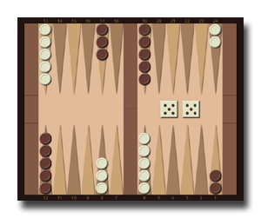
Backgammon

Slide 16
Games
Number of players
Single-player: Solitaire, Tetris
Multi-player: Go, chess, Othello
Randomness factor
Deterministic: Go, chess
Random: backgammon, most card games, most video games

Slide 17
Language
Natural Language Understanding
Natural Language Generation
Dialogue
Beware of ambiguities!

Slide 18
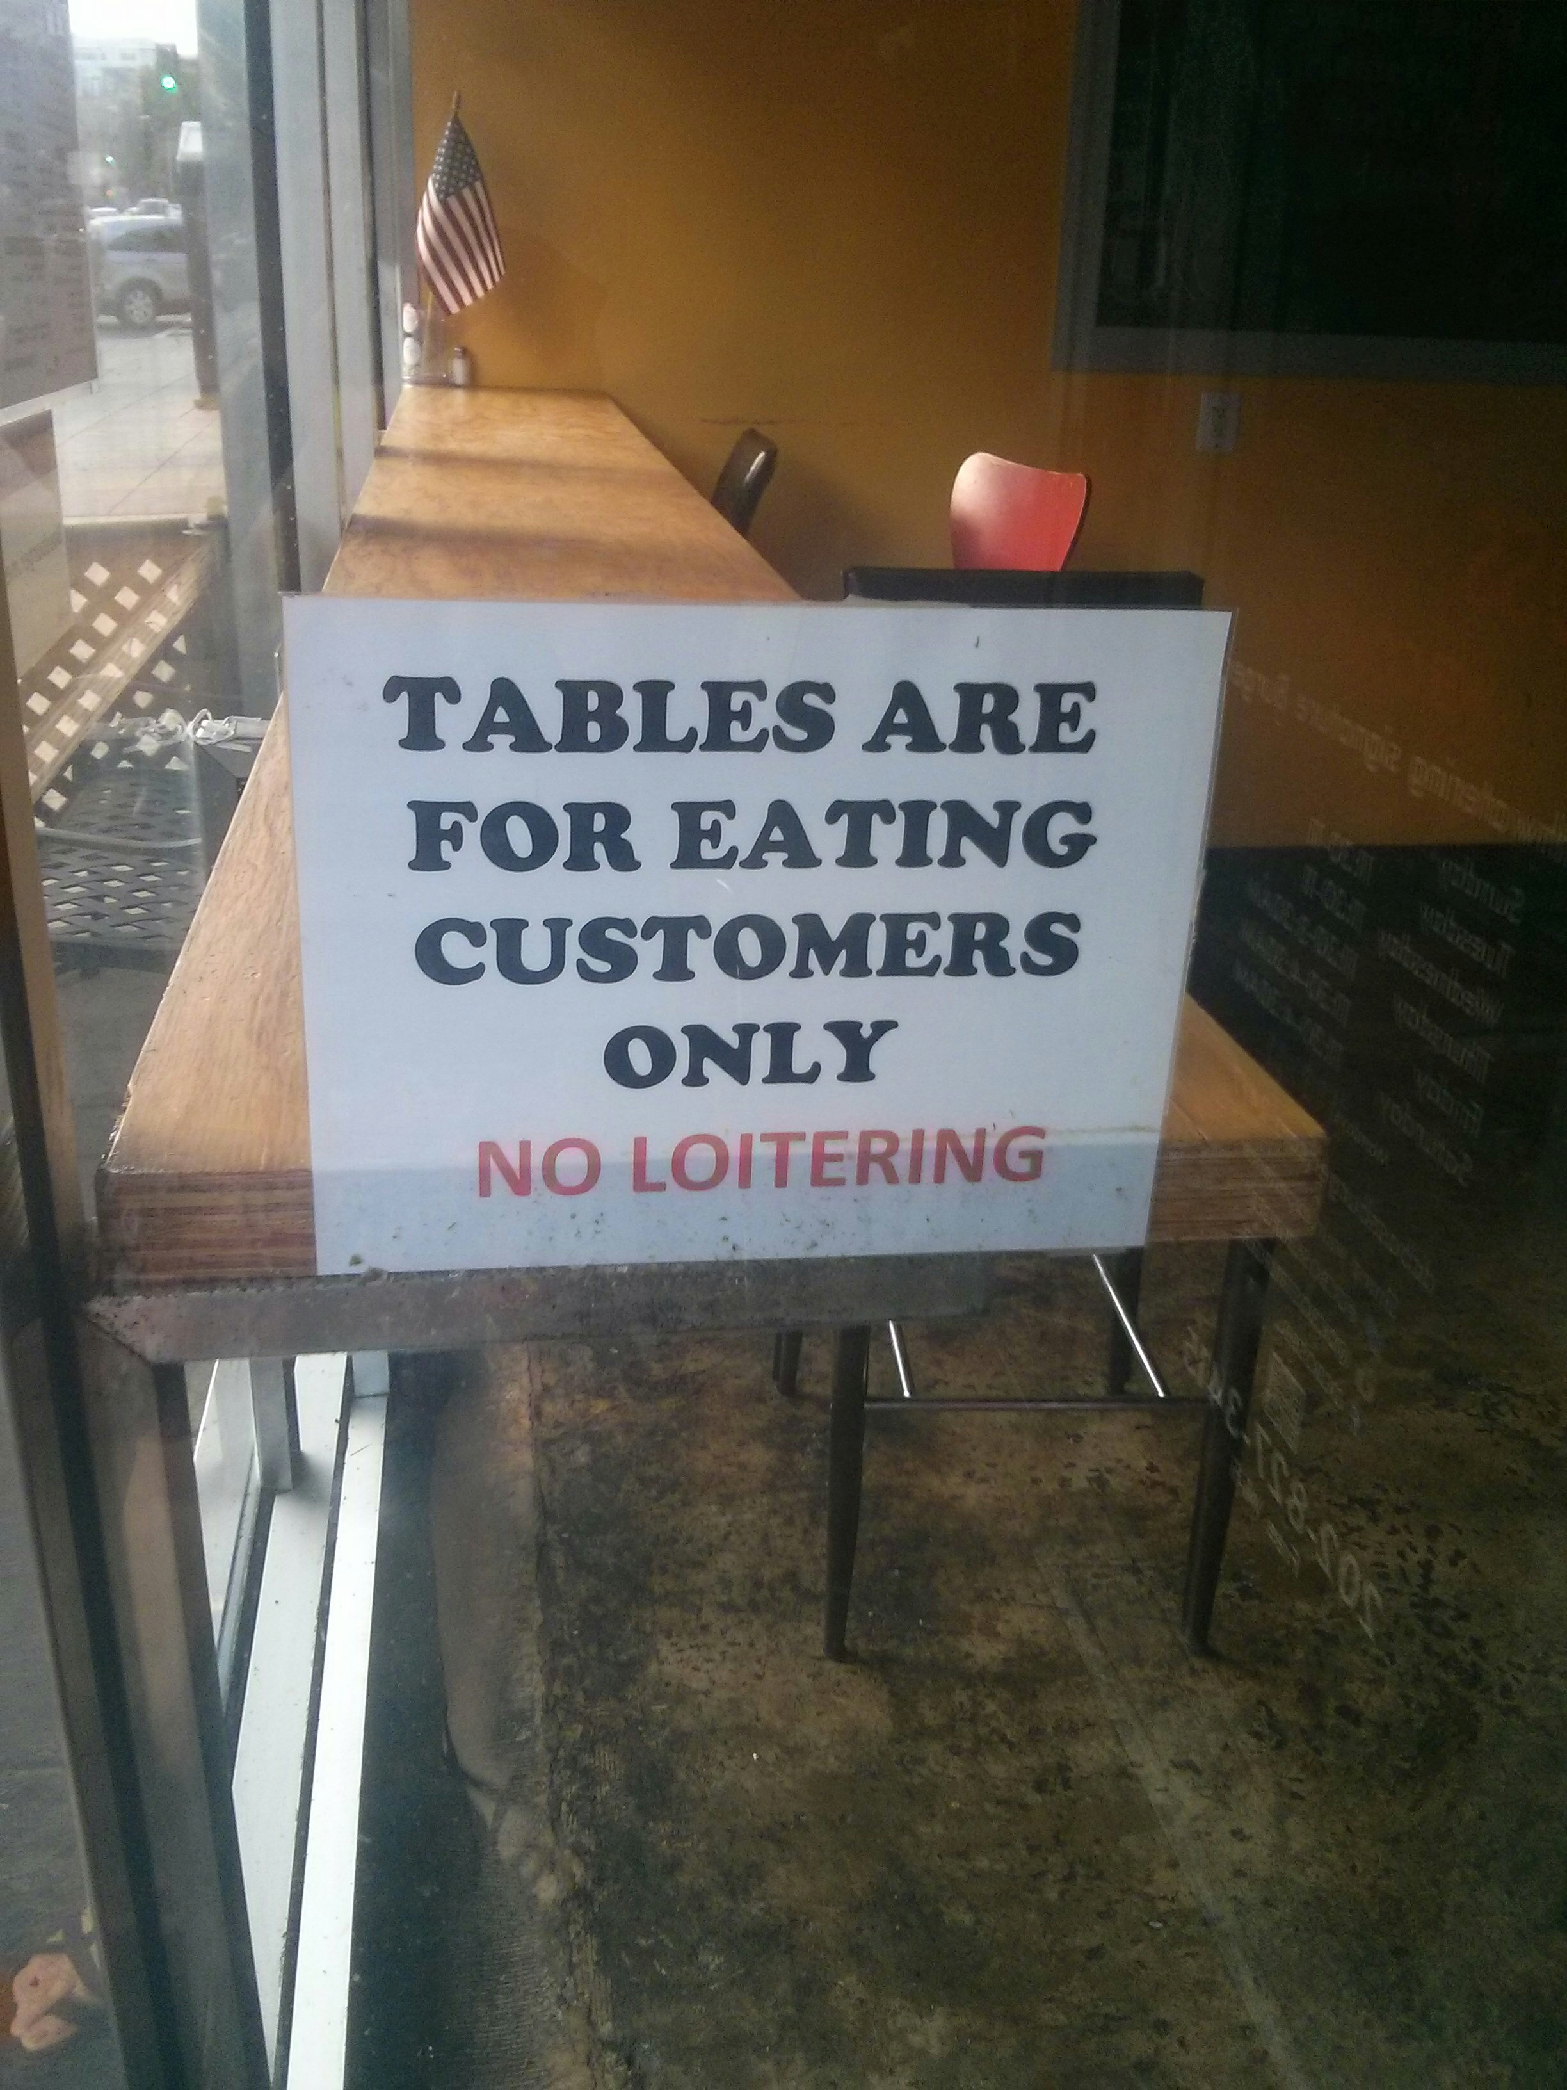

Slide 19
Learning
Machine learning
A subfield of computer science and artificial intelligence that deals with the construction and study of systems that can learn from data, rather than follow only explicitly programmed instructions.
Examples:
Learning to drive an autonomous car in a novel environment
Learning to adjust to a user’s behavior
Types of learning:
Supervised: labeled examples
Unsupervised: no examples
Semi-supervised: some examples
By reinforcement

Slide 20
Interacting with the Environment
Sensing
Speech
Video
Text
Sensors
Acting
Making decisions
Manipulating objects

Slide 21
What is a Computer?
Let’s start with these easier questions….

Slide 22


What is a Hammer?
A hammer is an AMPLIFIER for….

Slide 23
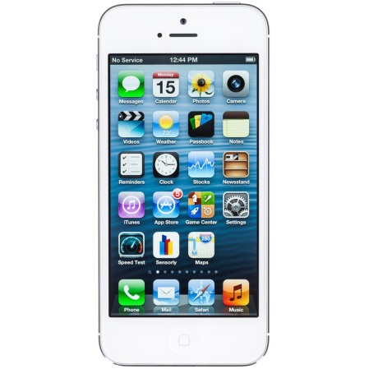


What is a Phone?
A phone is an AMPLIFIER for….

Slide 24
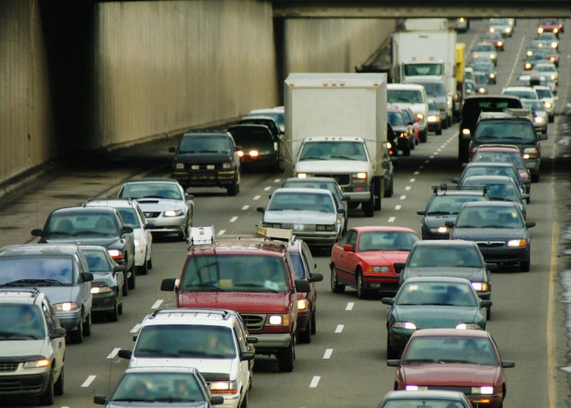

What is a Car?
A car is an AMPLIFIER for….

Slide 25

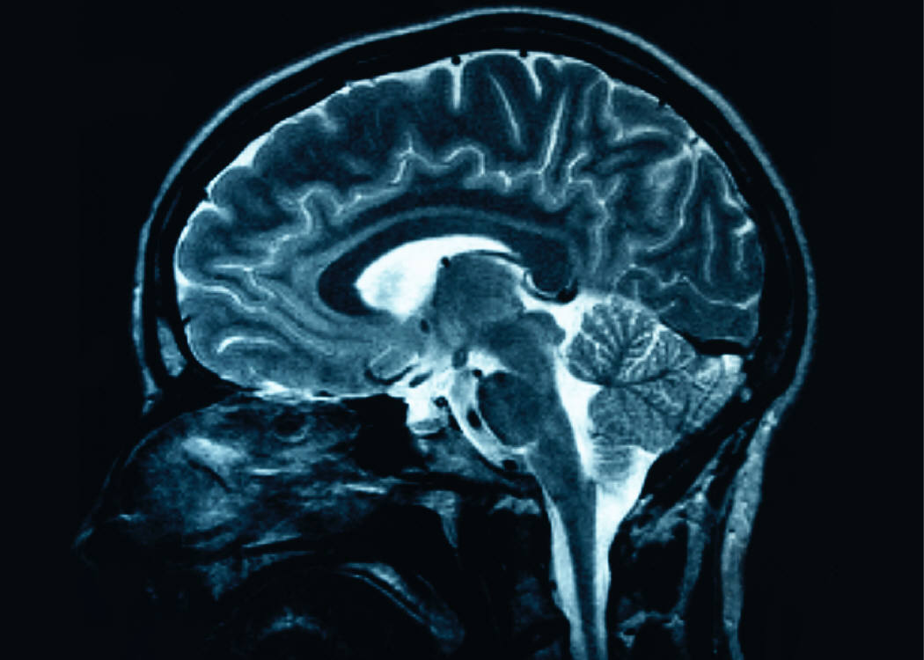
What is a Computer?
A computer is an AMPLIFIER for….

Slide 26
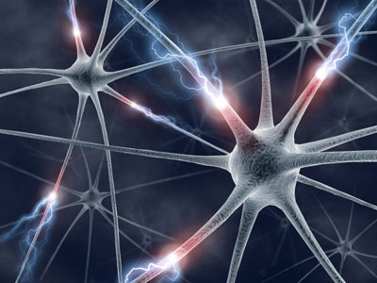
The Brain!

Slide 27
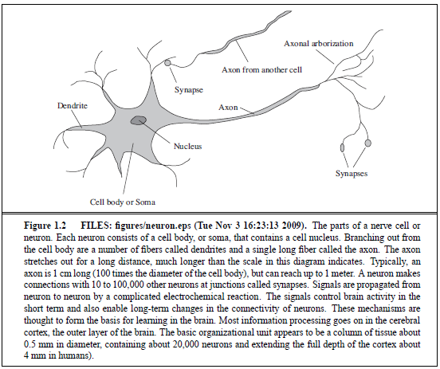

Slide 28
The Brain!
50-100B of these in a human brain
10,000s of connections each!
~10B critical pyramidal cells involved with cognition
1000 trillion (1 quadrillion) connections!
Why is it so wrinkled?
More brain surface (cerebral cortex) can fit in our skull
Frontal lobes oversized by mammalian standards
Vision processing oversized
Three times larger than next avg mammal

Slide 29

The Brain!
What does it do?
Long-term memory
Declarative (explicit) memory
knowing what
facts and events
conscious recall
Procedural (implicit) memory
knowing how
skills
unconscious recall
Short-term memory
Temporary memory
typically 10-15 seconds
usually about seven items

Slide 30
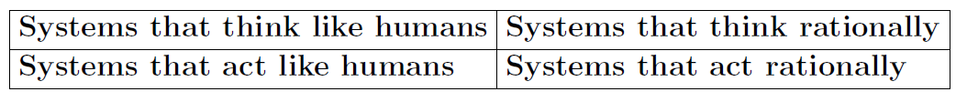
What is AI?
Views of AI fall into four categories:
The textbook advocates "acting rationally“.
This is not the only approach!

Slide 31
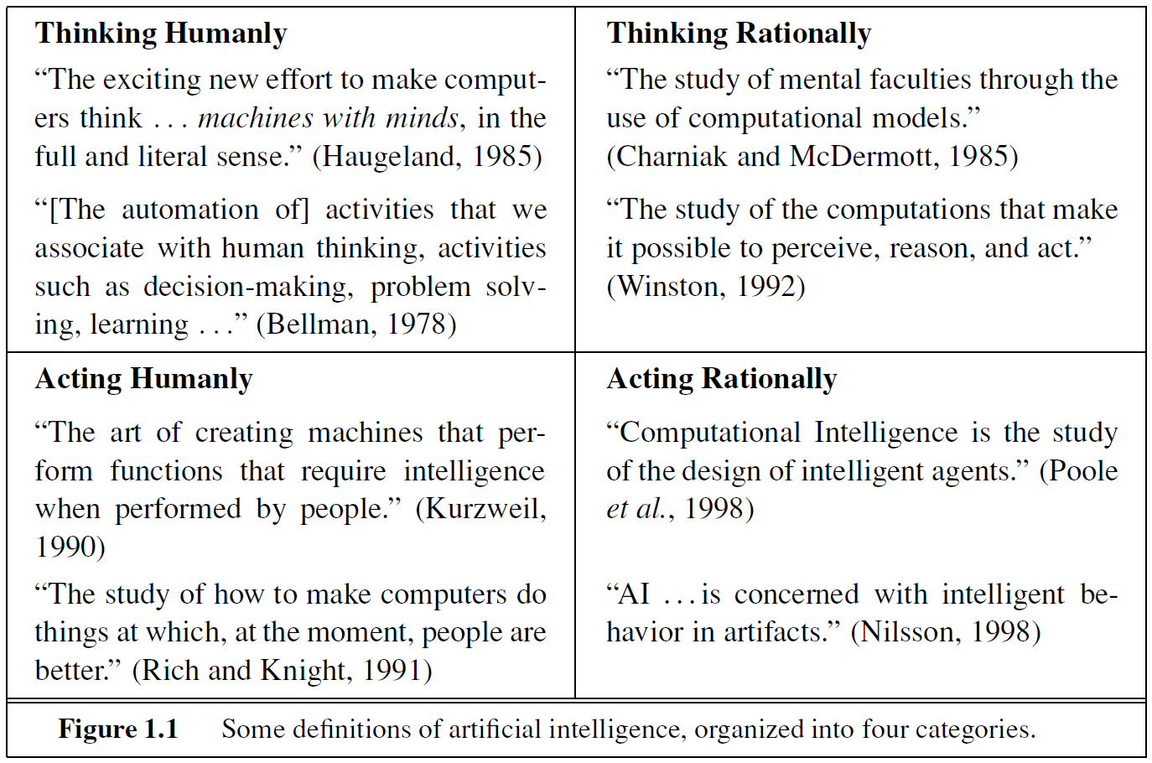
Eight Definitions of AI

Slide 32
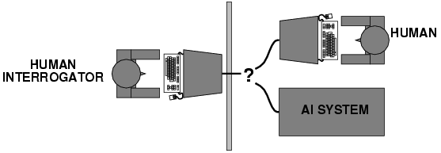
Acting humanly: Turing Test
Turing (1950) "Computing machinery and intelligence":
"Can machines think?" → "Can machines behave intelligently?"
Operational test for intelligent behavior: the Imitation Game
Predicted that by 2000, a machine might have a 30% chance of fooling a lay person for 5 minutes
Anticipated all major arguments against AI in following 50 years
Suggested major components of AI: knowledge, reasoning, language understanding, learning
The total Turing test would also involve vision and robotics

Slide 33
Thinking humanly: cognitive modeling
1960s "cognitive revolution": information-processing psychology
The General Problem Solver – Newell and Simon – they tried not only to solve a problem but also to compare the system’s reasoning process to that of a human
Requires scientific theories of internal activities of the brain
How to validate? Requires
1) Predicting and testing behavior of human subjects (top-down)
2) Direct identification from neurological data (bottom-up)
Both approaches (roughly, Cognitive Science and Cognitive Neuroscience) are now distinct from AI

Slide 34
Thinking rationally: "laws of thought"
Aristotle: what are correct arguments/thought processes
Several Greek schools developed various forms of logic: notation and rules of derivation for thoughts; may or may not have proceeded to the idea of mechanization
Direct line through mathematics and philosophy to modern AI
Problems:
Not all intelligent behavior is mediated by logical deliberation
What is the purpose of thinking? What thoughts should I have?

Slide 35
Acting rationally: rational agent
Rational behavior: doing the right thing
The right thing: that which is expected to maximize goal achievement, given the available information
Doesn't necessarily involve thinking – e.g., blinking reflex – but thinking should be in the service of rational action

Slide 36
Rational Agents
An agent is an entity that perceives and acts
This course is about designing rational agents
Abstractly, an agent is a function from percept histories to actions:
[f: P* → A]
For any given class of environments and tasks, we seek the agent (or class of agents) with the best performance
Caveat: computational limitations make perfect rationality unachievable
design best program for given machine resources
Example: a polynomial algorithm for an exponential problem
Satisficing!

Slide 37

Vacuum-cleaner world
Percepts: location and contents, e.g., [A,Dirty] Actions: Left, Right, Suck, NoOp

Slide 38
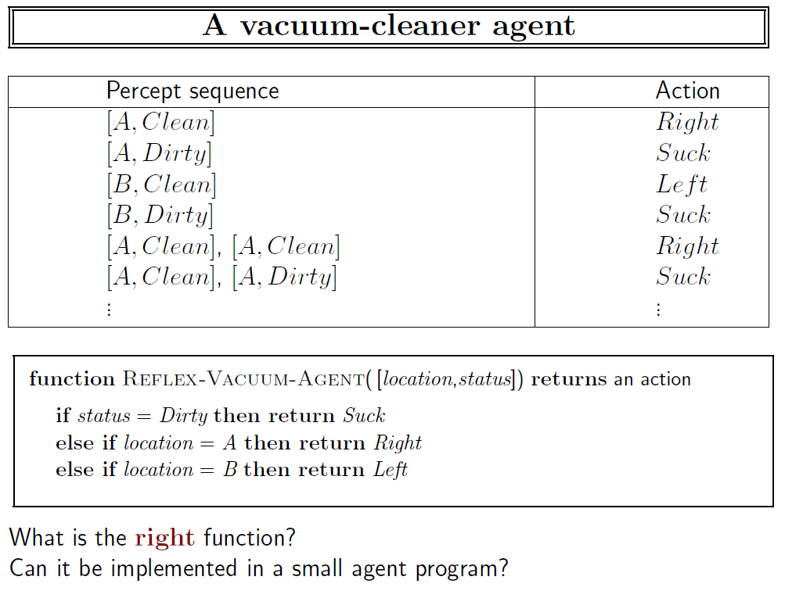

Slide 39
AI prehistory
Philosophy Logic, methods of reasoning, mind as physical system foundations of learning, language, rationality
Mathematics Formal representation and proof algorithms, computation, (un)decidability, (in)tractability, probability
Economics Utility, decision theory
Neuroscience Physical substrate for mental activity
Psychology Phenomena of perception and motor control, experimental techniques
Computer engineering Building fast computers
Control theory Design systems that maximize an objective function over time
Linguistics Knowledge representation, grammar, dialogue

Slide 40
Abridged history of AI
1943 McCulloch & Pitts: Boolean circuit model of brain
1950 Turing's "Computing Machinery and Intelligence"
1956 Dartmouth meeting: "Artificial Intelligence" adopted
1950s Early AI programs, including Samuel's checkers program, Newell & Simon's Logic Theorist
1960s First expert systems (e.g., DENDRAL)
1965 Robinson's complete algorithm for logical reasoning
1966—73 AI discovers computational complexity; Neural network research almost disappears
1969—79 Early development of knowledge-based systems (e.g., Winograd’s SHRDLU)

Slide 41
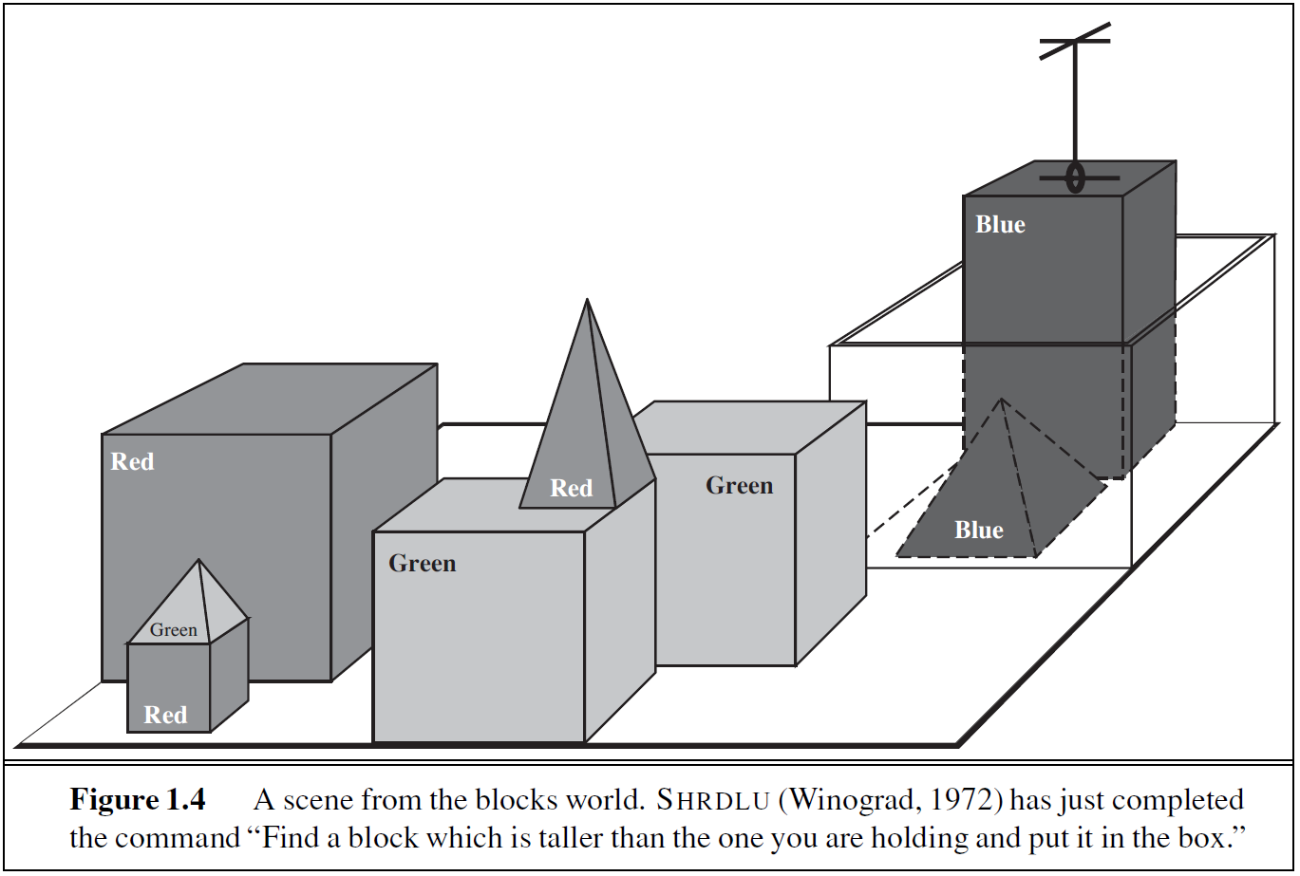

Slide 42
Abridged history of AI
1980-- AI becomes an industry
1986-- Neural networks return to popularity
1987-- AI becomes a science
1989-- Statistical methods, e.g., for NLP (e.g., IBM’s MT system)
1995-- The emergence of intelligent agents
2010-- Big data, social media
2010-- “Deep Learning”, practical AI (Siri, automated cars)

Slide 43
State of the Art
Deep Blue defeated the reigning world chess champion Garry Kasparov in 1997
Proved a mathematical conjecture (Robbins conjecture) unsolved for decades
Driving autonomously 98% of the time from Pittsburgh to San Diego
During the 1991 Gulf War, US forces deployed an AI logistics planning and scheduling program that involved up to 50,000 vehicles, cargo, and people
NASA's on-board autonomous planning program controlled the scheduling of operations for a spacecraft
Dr. Fill can solve crossword puzzles better than most humans
AI Knowledge based system components are embedded in many real-world applications
Jeopardy!! Watson beats the best humans…in 2011
Siri, Alexa, Cortana, OK Google
Google Translate
Facebook babi
Google beat Lee Sedol in the game of Go in 2016

Slide 44
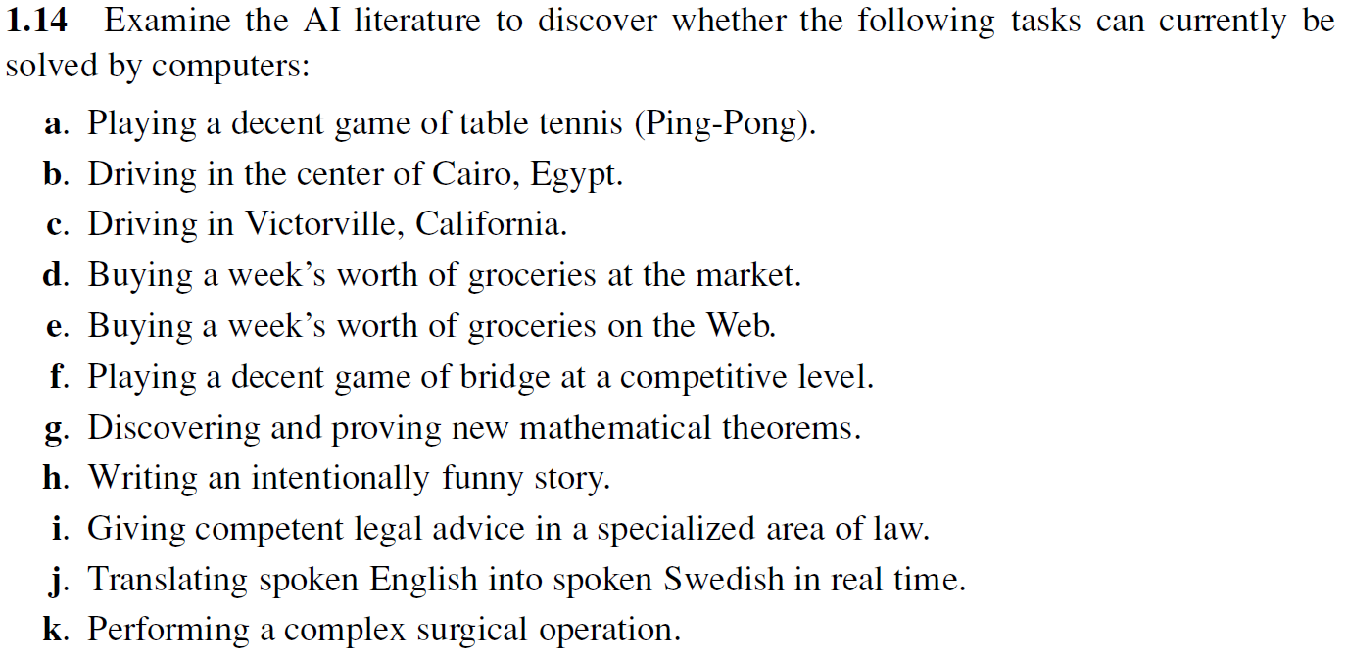
Exercise

Slide 45
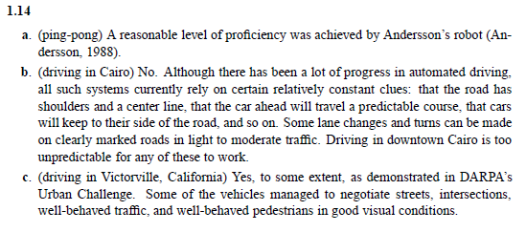

Slide 46
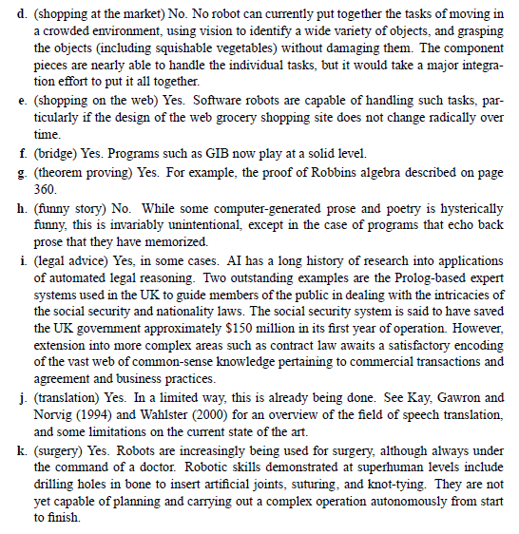

Slide 47
Related Courses and Journals
Related courses at Yale
Natural Language Processing (Radev)
Computer Vision (Zucker)
Data Mining and Machine Learning (Lafferty, Wolf, Krishnaswamy)
Neural Networks (Barron)
Intelligent Robotics (Scaz)
Conferences and journals
IJCAI, AAAI
AISTATS, UAI
ACL, NAACL, EMNLP
ICML, NIPS, ICLR
AIJ, JAIR, CL, TACL, JMLR

Slide 48
Other Applications of AI
Handwriting recognition (full addresses)
Machine translation
Search engines
Speech understanding
Financial trading
Recommendation systems
Business logistics
Navigation
Fraud detection
Autonomous cars (since 2005 – DARPA’s Grand Challenge)

Slide 49
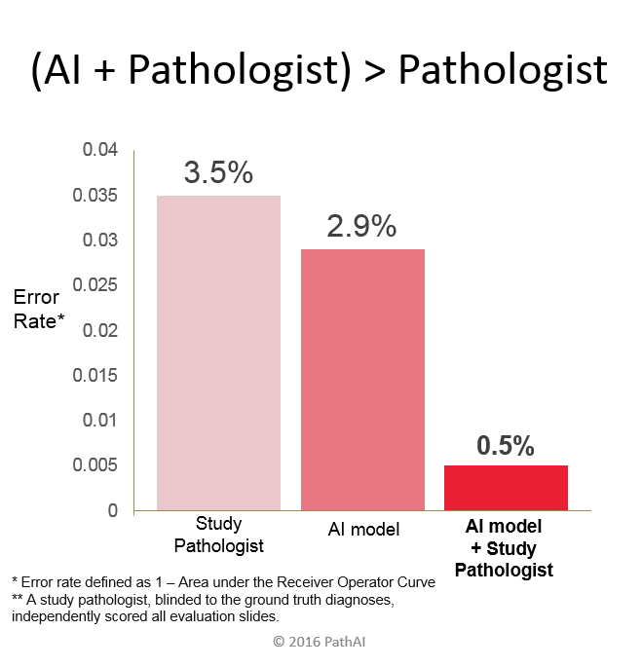
https://blogs.nvidia.com/blog/2016/09/19/deep-learning-breast-cancer-diagnosis/

Slide 50
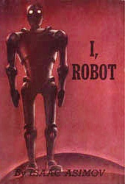
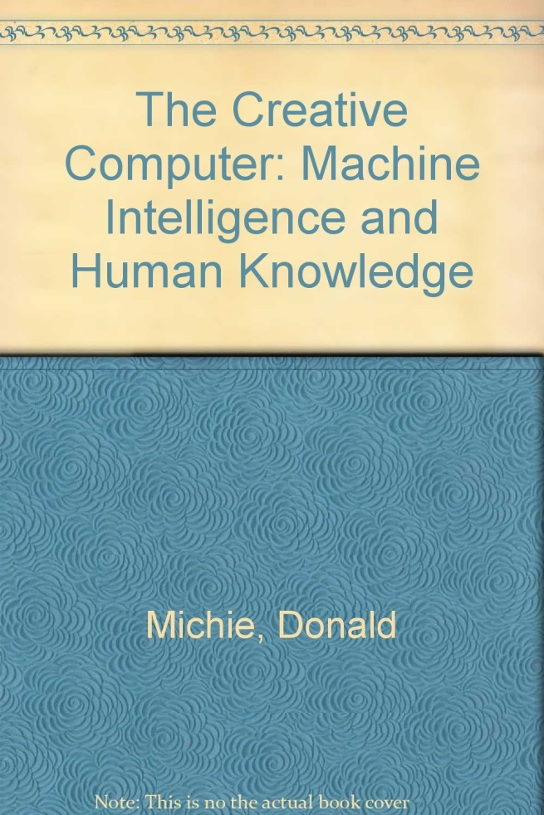

Readings
https://www.goodreads.com/list/show/485.Best_artificial_intelligence_books
http://www.computerworld.com/article/2488478/emerging-technology/ai-gets-its-groove-back.html

Slide 51
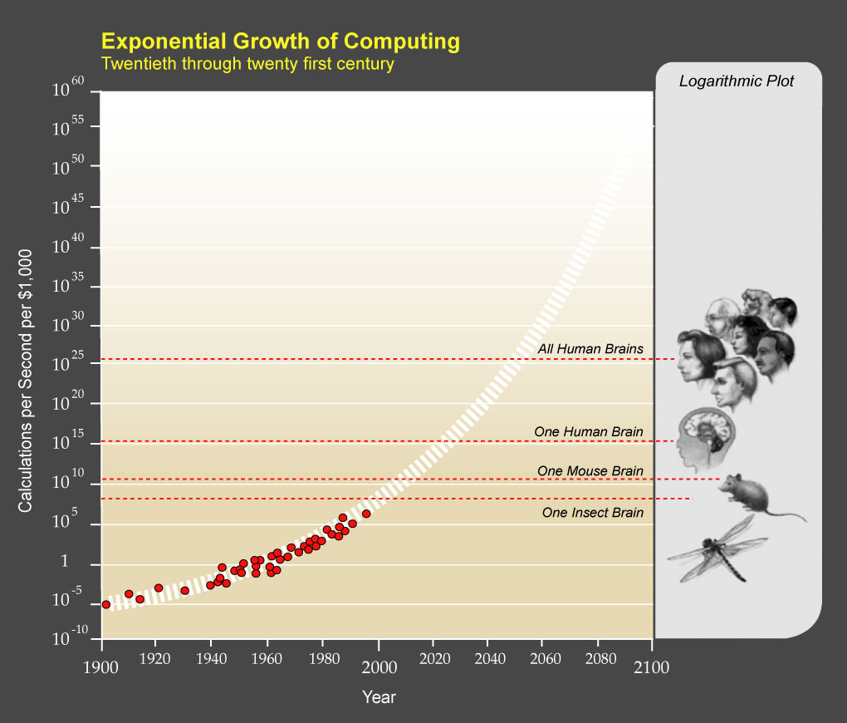
The Singularity
Courtesy of Ray Kurzweil and Kurzweil Technologies, Inc.

Slide 52
Autonomous Car Videos
https://www.youtube.com/watch?v=-96BEoXJMs0
NVIDIA AI Car
https://www.youtube.com/watch?v=NC79pdZ5Rr0
Neurala AI Car
https://youtu.be/5hFvoXV9gII
Princeton Deep Driving
http://deepdriving.cs.princeton.edu/

Slide 53
Robot Videos
https://www.youtube.com/watch?v=bivS1qQKHec
Beijing RoboCup Challenge
https://www.youtube.com/watch?v=XgRw42oHN-Y
Robocup 2016
https://www.youtube.com/watch?v=rVlhMGQgDkY
Boston Dynamics Atlas
https://www.youtube.com/watch?v=X_VLR7vU-8c
Shipping Warehouse Robots

Slide 54
Other Videos
https://www.youtube.com/watch?v=vFr3K2DORc8
AlphaGo vs. Lee Sedol
https://www.youtube.com/watch?v=-O01G3tSYpU
A DARPA perspective
https://www.youtube.com/watch?v=21EiKfQYZXc
Andrew Ng - Artificial Intelligence is the New Electricity
https://www.youtube.com/watch?v=vQXAsdMa_8A
Demis Hassabis – Towards General Artificial Intelligence
https://www.youtube.com/watch?v=8nt3edWLgIg
Sam Harris
https://www.youtube.com/watch?v=LSHZ_b05W7o
Daddy's Car: a song composed by Artificial Intelligence - in the style of the Beatles
https://www.youtube.com/watch?v=V1eYniJ0Rnk
Google DeepMind's Deep Q-learning playing Atari Breakout
https://www.youtube.com/watch?v=TnUYcTuZJpM
Google Deep Mind

Slide 55
Important points about AI
Problem solving and decision making
Maximizing utility
Very difficult tasks
Computational complexity (even at the level of constants)
Heuristics and knowledge are needed
However, the definition changes over time
Not necessarily perfect solutions
Satisficing
Uncertainty
Societal impact
Affecting billions
Ethics

Slide 56
AI Method
Real life problem -> model -> algorithms
Example: autonomous car navigation
Separate modeling (stay in lane/switch lane) from algorithms
Machine learning approach: labeled training data given as input to learning algorithm
Generalization (training to test)

Slide 57
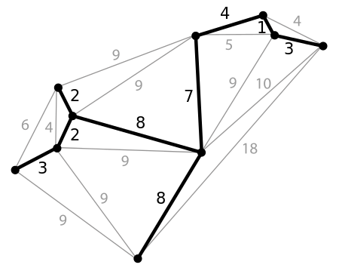
Optimization
min f(x)
Discrete optimization
Dynamic programming
Integer programming
Continuous optimization
Gradient descent

Slide 58
Takeaways
Tractable approaches to exponential problems
Using knowledge, experience, heuristics
Learning, Logic, Language, Games
Social impact: jobs, security, ethics

Slide 59
Artificial Intelligence
Class Logistics

Slide 60

Textbook
Stuart Russell and Peter Norvig Artificial Intelligence: A Modern Approach Prentice Hall, 2009, Third Edition

Slide 61
Book Chapters
Introduction and Agents (chapters 1,2)
Search (chapters 3,5,6)
Logic (chapters 7,8,9)
Knowledge Representation (chapter 12)
Uncertainty (chapters 13,14)
Learning (chapter 18)
Natural Language Processing (chapter 22,23)
Other topics
Autonomous Cars, Deep Learning, Reinforcement Learning, etc.

Slide 62
Course Information
Official prerequisites:
After CPSC 201 and 202 (or by permission of the instructor)
Description:
Introduction to artificial intelligence research, focusing on reasoning and perception. Topics include knowledge representation, predicate calculus, temporal reasoning, vision, robotics, planning, and learning.
Skills
Quantitative Reasoning

Slide 63
Course Dates
AUG
31
SEP
5 7 12 14 19 21 26 28
OCT
3 5 10 12 17 24 26 31
NOV
2 7 9 14 16 28 30
DEC
5 7
Important dates:
Midterm (per registrar) Friday 10/27
Last day of classes Friday 12/8
Finals 12/15 – 12/20

Slide 64
Syllabus
Introduction
Introduction to AI, Python for AI, Agent-based view of AI
Problem Solving and Search
Problem Solving and Search, Informed Search, Heuristic Search, Advanced Search, Game Playing, Adversarial Search, Genetic Algorithms, Constraint Satisfaction
Language and Logic
Logical Agents, Predicate Logic, First Order Logic, Inference, Knowledge Representation, Natural Language Processing and Communication, Speech Processing (if time)
Reasoning under Uncertainty
Quantifying Uncertainty, Intro to uncertainty, Probabilistic Reasoning, Bayesian Networks
Learning
Learning from Examples, Classification and Clustering, Markov Decision Processes, Neural Networks, Reinforcement Learning, Autonomous Cars
Notes:
MOVE ELSEWHERE?

Slide 65
Useful Background
Linear algebra
vectors and matrices
Probabilities
random variables
discrete and continuous distributions
Bayes’ theorem
Programming
Python in a UNIX environment.
text manipulation

Slide 66
Grading
Assignments
Programming assignments (50%)
Other assignments (10%)
Midterm (15%)
Final (20%)
Class participation (5%)

Slide 67
Assignments (draft list)
HW 0: Introduction to the Course Environment
HW 1: Mathematical Models (problem set)
HW 2: Search (Pacman*)
HW 3: Game Playing (Othello)
HW 4: Language and Logic (Deep Learning and NLP)
HW 5: Classification (Autonomous Cars)
HW 6: Reinforcement Learning (AI Gym)
*Pac-Man is a registered trademark of Namco-Bandai Games, used here for educational purposes

Slide 68
How to get the most out of the class?
Attend the lectures and study the slides
Course syllabus + slides = road map
Some material may not be found in any of the readings
Hands on experience
Implement what you’ve learned
Ask questions in and after class

Slide 69
Questions?
Use the right channels for communications
Piazza (not Canvas)
In special cases (e.g., sickness, regrading), email the instructors
Include [CPSC470] or [CPSC570] or [AI Class] in the subject line
Office Hours:
Instructor: Fridays 2-4 pm in room 319, 17 Hillhouse

Slide 70
Courses at Other Places
Brick-and-Mortar
Stanford (Percy Liang)
Berkeley (Pieter Abbeel and Dan Klein)
Online
Deep Learning (Andrew Ng) on Coursera

Slide 71
The Alphabet Soup
AI (Artificial Intelligence)
ML (Machine Learning)
DS (Data Science)
DL (Deep Learning)
NLP (Natural Language Processing)

Slide 72
Research in AI
Conferences:
AAAI, IJCAI
Journals:
JAIR, Artificial Intelligence
University centers:
Berkeley, Stanford, MIT, CMU, Columbia, Cornell, Michigan, Texas, Edinburgh, Oxford, Cambridge…
Industrial research sites:
Google (+ Brain, DeepMind), Facebook, MSR, IBM, Baidu…

Slide 73
Academic Honesty
Unless otherwise specified in an assignment all submitted work must be your own, original work. Any excerpts, statements, or phrases from the work of others must be clearly identified as a quotation, and a proper citation provided.
Any violation of the University’s policy on Academic and Professional Integrity will result in serious penalties, which might range from failing an assignment, to failing a course, to being expelled from the program.
Violations of academic and professional integrity will be reported to Student Affairs. Consequences impacting assignment or course grades are determined by the faculty instructor; additional sanctions may be imposed.

Slide 74
Student Mental Health and Wellbeing
Yale University is committed to advancing the mental health and wellbeing of its students.
If you or someone you know is feeling overwhelmed, depressed, and/or in need of support, services are available.

Slide 75
Students with Disabilities
If you think you need an accommodation for a disability, please let me know at your earliest convenience.
Some aspects of this course, the assignments, the in-class activities, and the way we teach may be modified to facilitate your participation and progress.
I will treat any information that you provide in as confidential a manner as possible.

Slide 76
Programming Language
The programming assignments will be in Python.
You are expected to either know Python already or to learn it on your own.
The AIMA code base has been installed on the Zoo machines
http://www.cs.berkeley.edu/~russell/code/doc/install.html
Other machines may also be available.

Slide 77
Submitting Assignments
In the absence of a prior emailed authorization from the instructor, you should turn in your assignments electronically by 11:59:59 PM on the due date. For each day (or fraction of a day) that your submission is late, it will be penalized 10%, for a maximum of 30%. After three days, the assignment will be given a score of zero.
You will need to hand in the source code for the project, relevant documentation, and a script of a test run of your program to show that it actually works on the Zoo machines.

Slide 78
Integrity Policies
Collaboration policy:
You may discuss the course material and the textbook with other students. You may also discuss the requirements of the assignments. However, you cannot get help with the assignments and exams themselves in oral or written form from anyone. If you are unsure about this policy, ask the instructors.
Honesty policy:
We will be using high grade plagiarism detection code
Do not copy other people's code or misrepresent it as yours, period.

Slide 79
Specifics
Coding and write up should be done independently
Do not show your work to anyone
Do not look at anyone’s work
Do not use existing web code (e.g., github)

Slide 80
Grading Appeals
If you have a question about your grade on a particular assignment (or exam), write a short email to the TA in charge of that assignment.
Please submit any such requests within a week of receiving your grade.

Slide 81
Job Prospects
Software Engineering
Finance
Government
Teaching
AI Research
(see next slide)

Slide 82


Slide 83
AI

